Slide 1
Travel Destinations in Life
Name
Date

Slide 2

Future Destinations
Life goals
I purpose to run 10km every morning for two years to manage my health.
I aim to pursue my career in the next five years by doing up to a postgraduate degree.
My aim is to acquire the best grades in every step throughout my academics.
I plan to start off a business by offering graphic design services, which will kick off in the next two years, and my goal is to earn $100 daily at the start.
In the next three years, I plan to cut off social connections that do not build me up towards any aspect of my life.

Slide 3

Driving Playlist
Inspirational Music Playlist
Heroes by David Bowie
Touch the Sky by Kanye West
Unwritten by Natasha Bedingfield
I’m the Best by Nicki Minaj
Inspirational Movies Playlist
The Shawshank Redemption
Gran Torino
Spirited Away
Rush
Of Mice and Men
Whipflash
Inspiring Quotes
Big journeys begin with the small steps.
The best way to get something is to begin.
If the plan doesn’t work, change the plan—but never the goal.

Slide 4
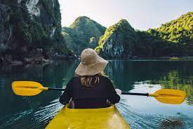
Rest Stops
Mind Refreshing Activities
Swimming
Hiking
Mountain Climbing
Bike Riding
Massage parlor visits
Play Guitar
Refreshing Places
Waterfalls
Prehistoric Caves
Mountains
Forest

Slide 5

Passengers & Crew
I want to have people who supports my goals and always see the best in me regardless of my weaknesses
My parents will be part of my life journey since they are the first people to push to do my best.
My uncle Smith who is also my mentor will be part of my journey.
I must cultivate a relationship with Brandon who inspires me through his inspirational writing.

Slide 6

Reminders to self
Personal Reminders
Life is short. Enjoy.
Live purposely.
Thoughts and Beliefs to Keep
Giving is fulfilling
Expectations brings disappointments
Habits to Keep
Helping the less privileged.
Doing the best in everything.
Habits to Work on
Impatience

Slide 7

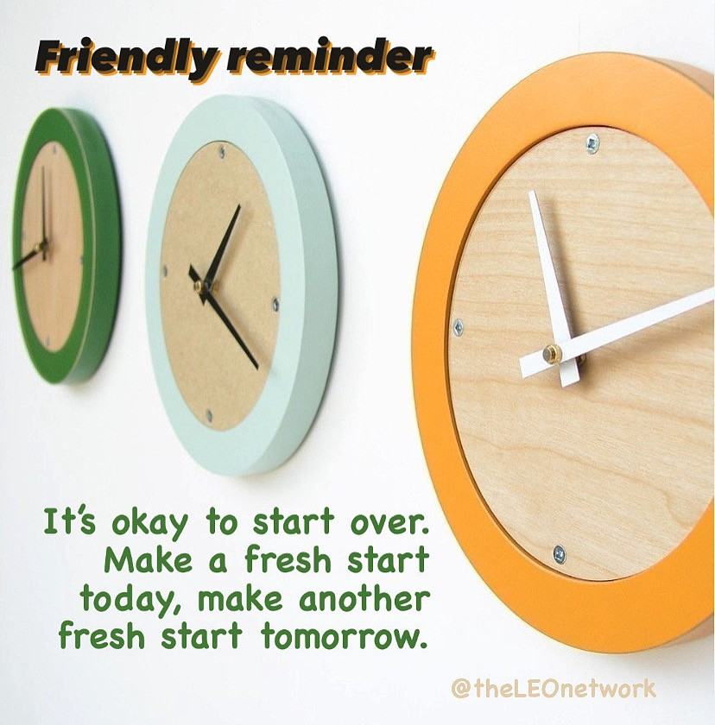
I can
Past Accomplishments and Happy Memories
Best Essay Writer Awards
Best Photographer of the Year
Winning Drama Club Awards
Best volunteer in Recross Society

